Slide 1

N. Sagar (192210568)
P. Bala Kishore (192210568)

Slide 2


Slide 3


Slide 4


Slide 5


Slide 6
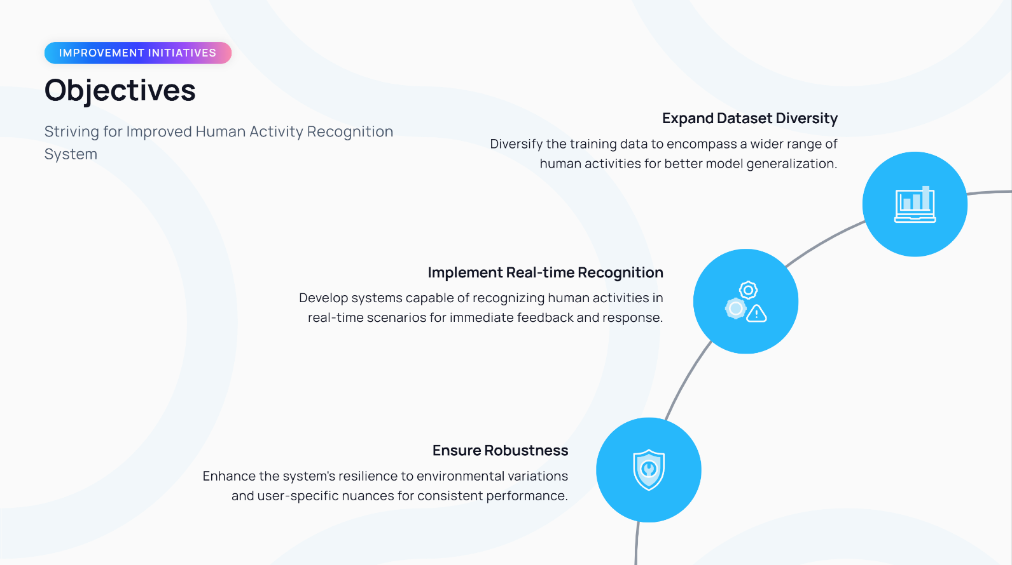

Slide 7


Slide 8


Slide 9


Slide 10
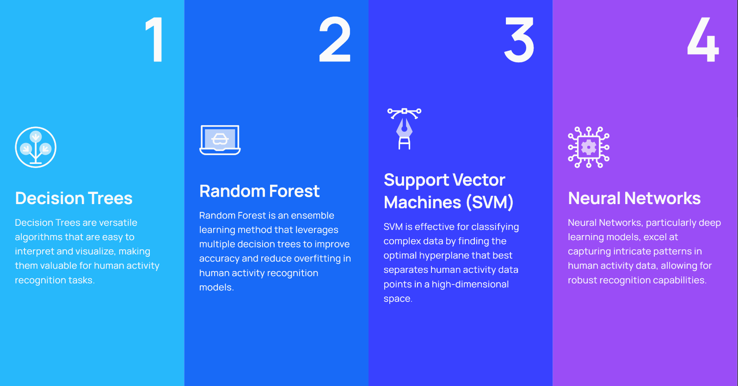

Slide 11


Slide 12

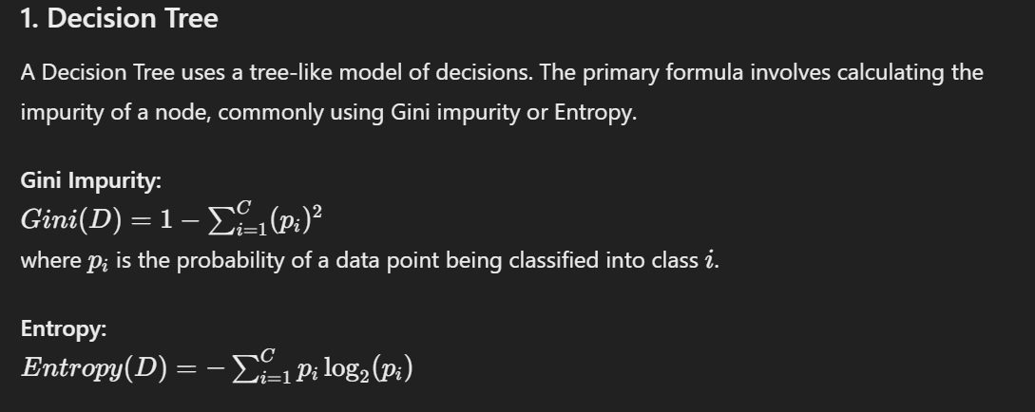

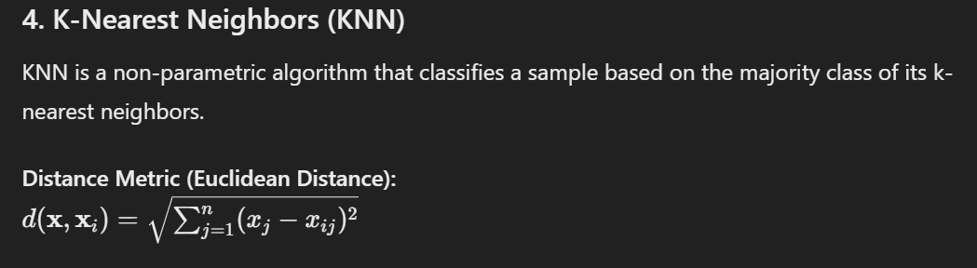
Code and Execution:
# Train and evaluate models
def train_and_evaluate(X_train, y_train, X_test, y_test):
models = {
'Decision Tree': DecisionTreeClassifier(),
'Random Forest': RandomForestClassifier(n_estimators=100),
'SVM': SVC(kernel='linear'),
'KNN': KNeighborsClassifier(n_neighbors=5),
'Logistic Regression': LogisticRegression(max_iter=1000)
}
results = {}
for model_name, model in models.items():
model.fit(X_train, y_train)
y_pred = model.predict(X_test)
accuracy = accuracy_score(y_test, y_pred)
report = classification_report(y_test, y_pred, output_dict=True)
results[model_name] = {'accuracy': accuracy, 'report': report}
return results
# Plot comparison graph
def plot_comparison(results):
accuracy_scores = [results[model]['accuracy'] for model in results]
model_names = list(results.keys())
plt.figure(figsize=(10, 6))
sns.barplot(x=model_names, y=accuracy_scores, palette='viridis')
plt.xlabel('Models')
plt.ylabel('Accuracy Score')
plt.title('Comparison of Model Accuracy')
plt.ylim(0, 1)
plt.show()

Slide 13
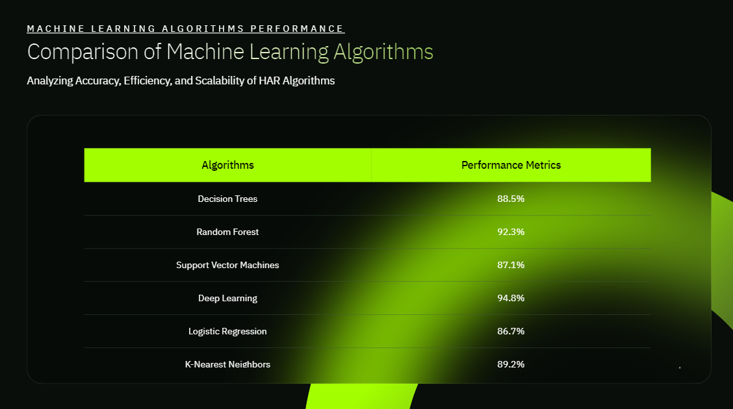

Slide 14


Slide 15


Slide 16


Slide 17


Slide 18


Slide 19


